Slide 1


Cost Effective Case Closures
Presenter: Noel Shenoi
June 2025
1790 N. Case Street
Orange, CA 92865
714-936-2706
noelshenoi@calclean.com
www.calclean.com
“We support our men and women who have served our country”

Slide 2
Summary of Presentation
Capabilities
  Storage Locations
  Technology
  Equipment
Case Studies
Current Rate Schedule
Recommendations
Summary

Slide 3
Capabilities
Hydrocarbons – Gasoline/Diesel (25-HP LRPs)
Chlorinateds (20-HP LRPs w/Carbon Vessels)
Jet Fuel / Heavier HCS
PFAS / PFOS
Storage Locations Around the USA

Slide 4
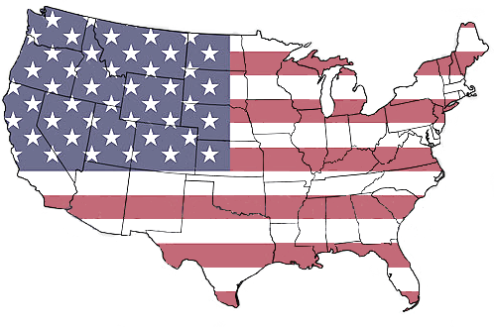
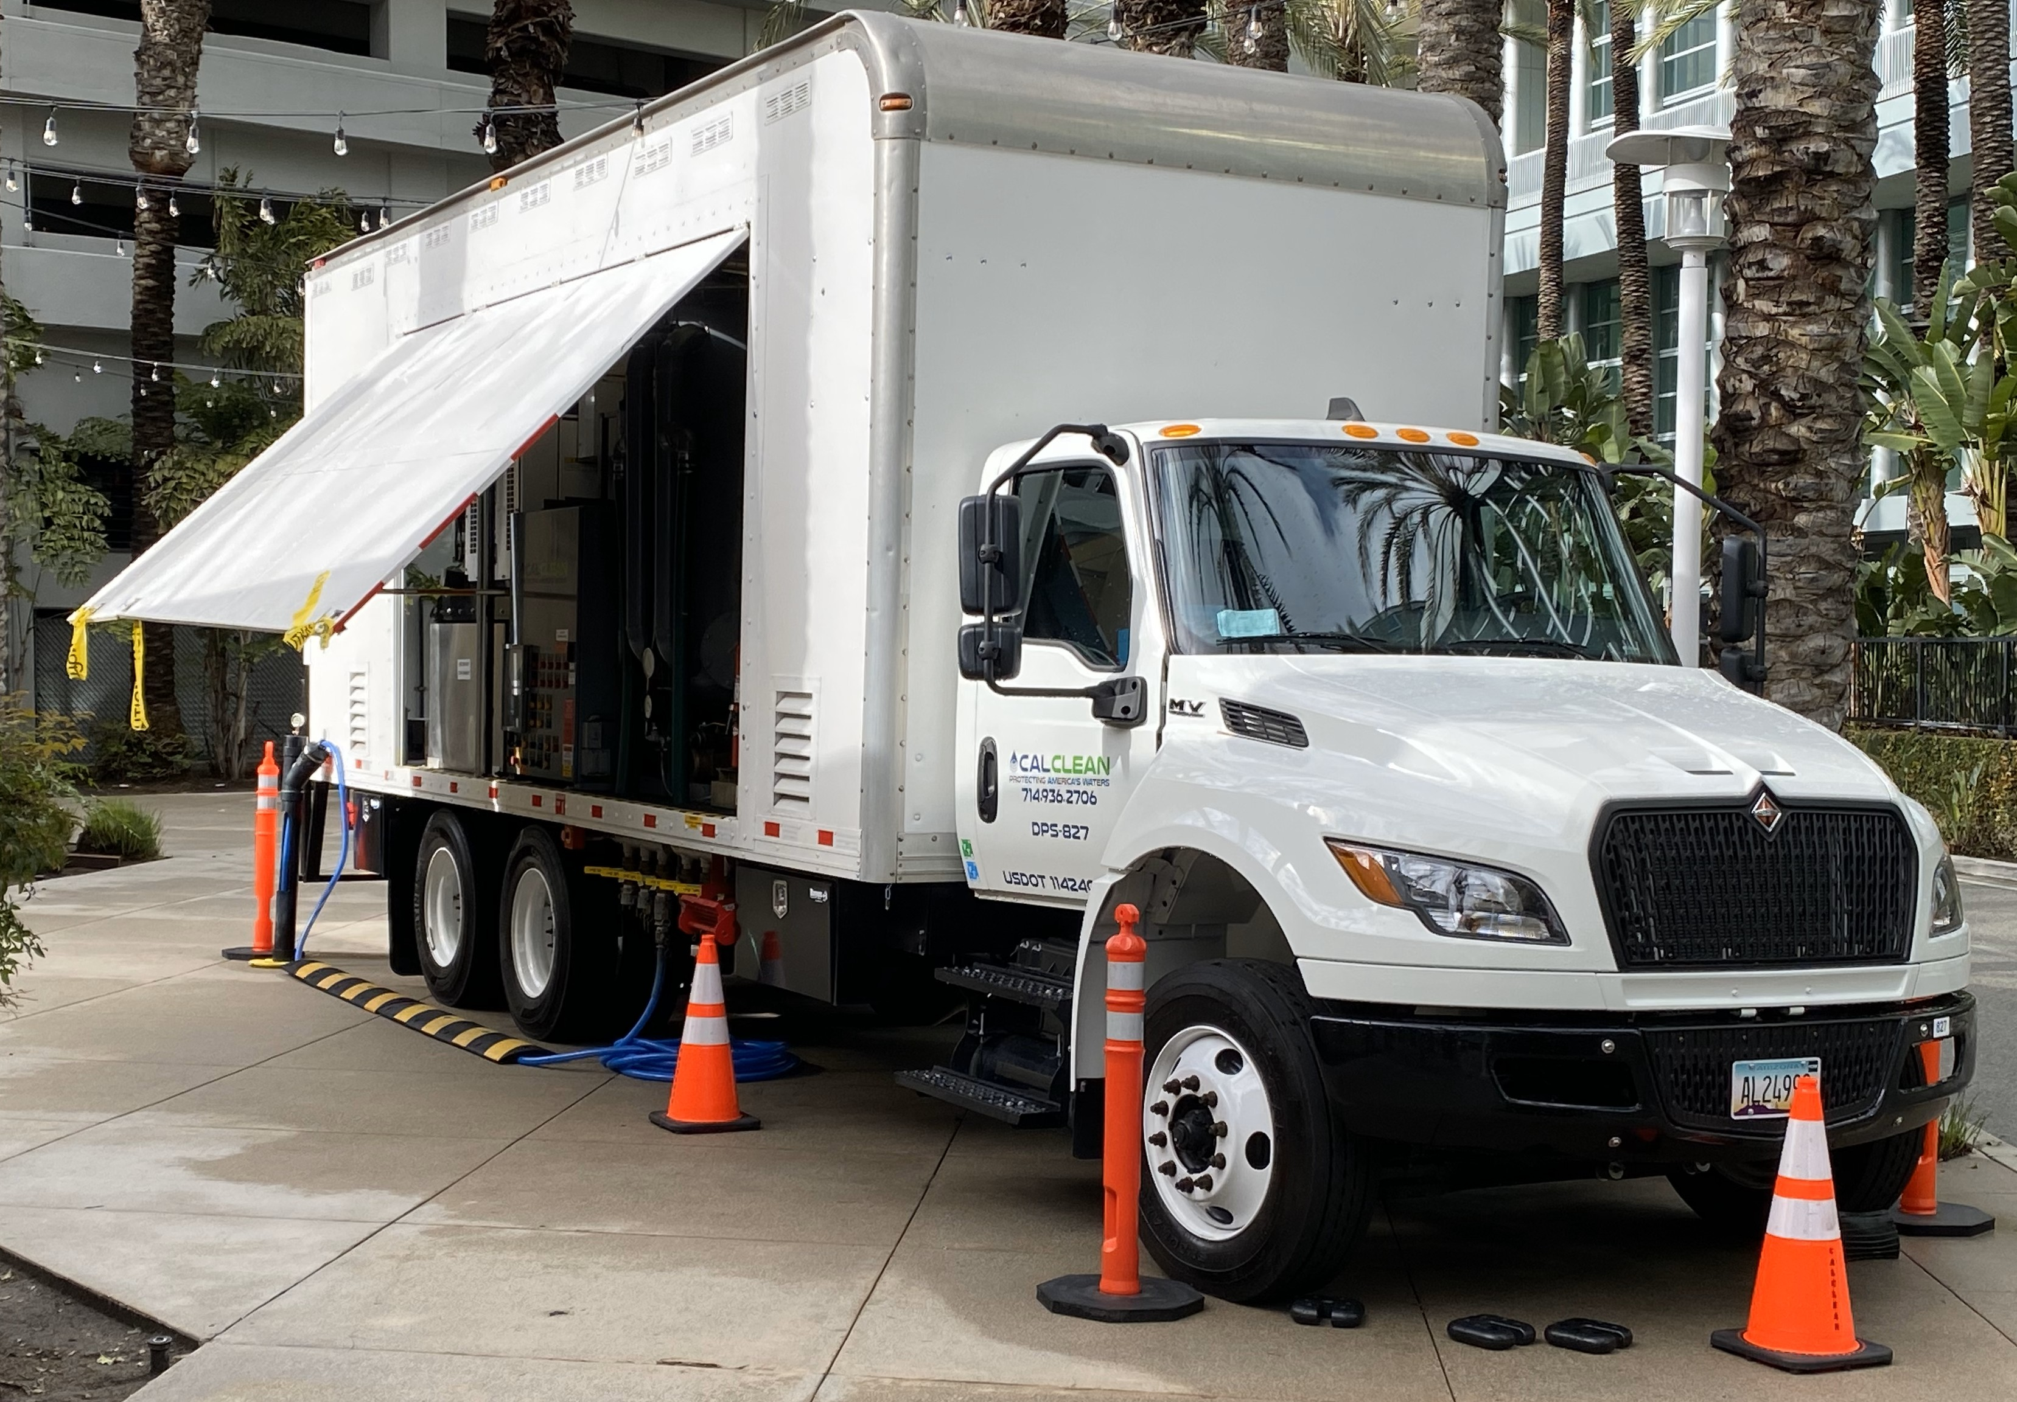
Storage Locations
States with
stored equipment
With Mobile Extraction Systems and
Mobile Water Treatment Systems
staged throughout the USA

Slide 5
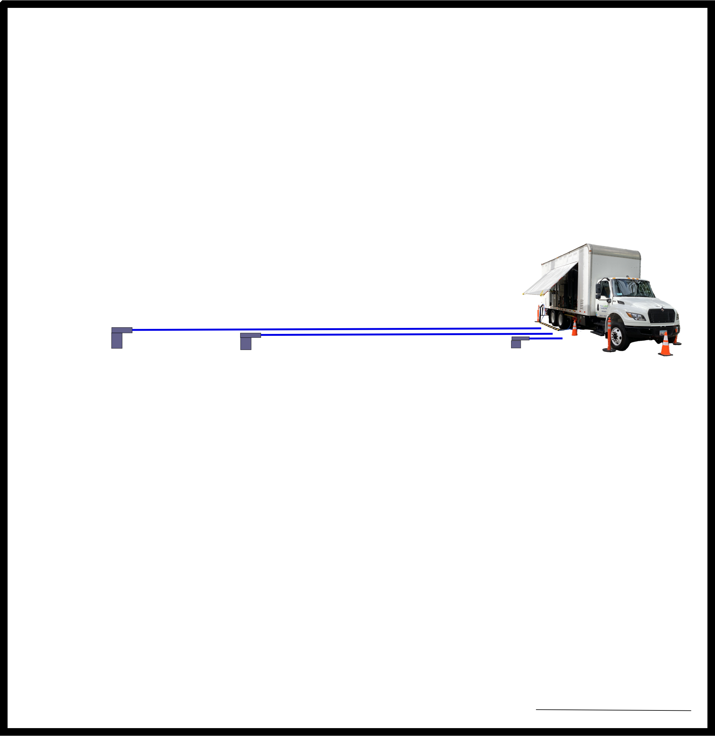

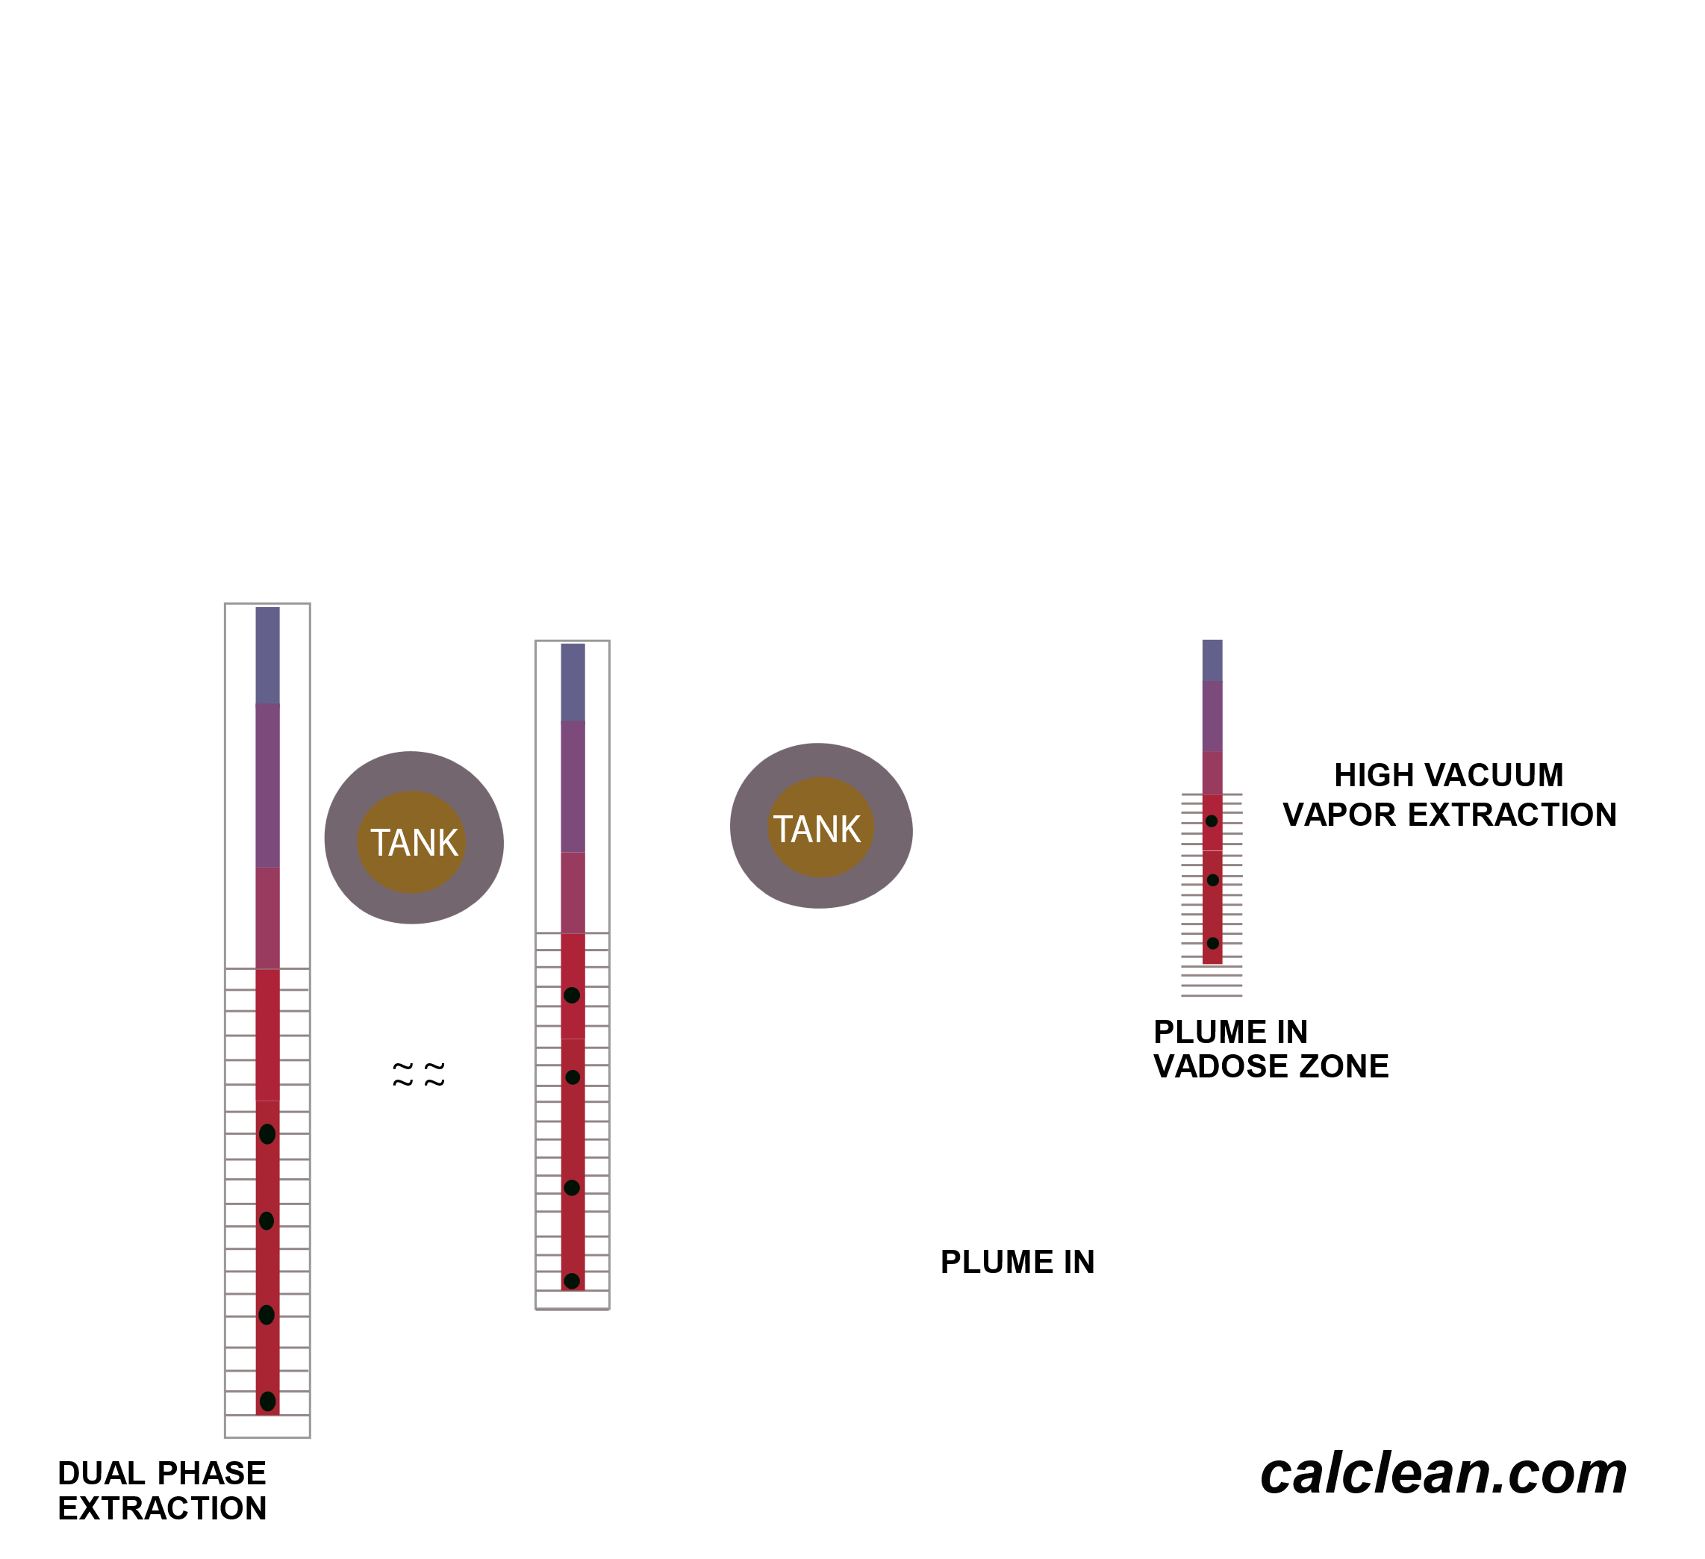
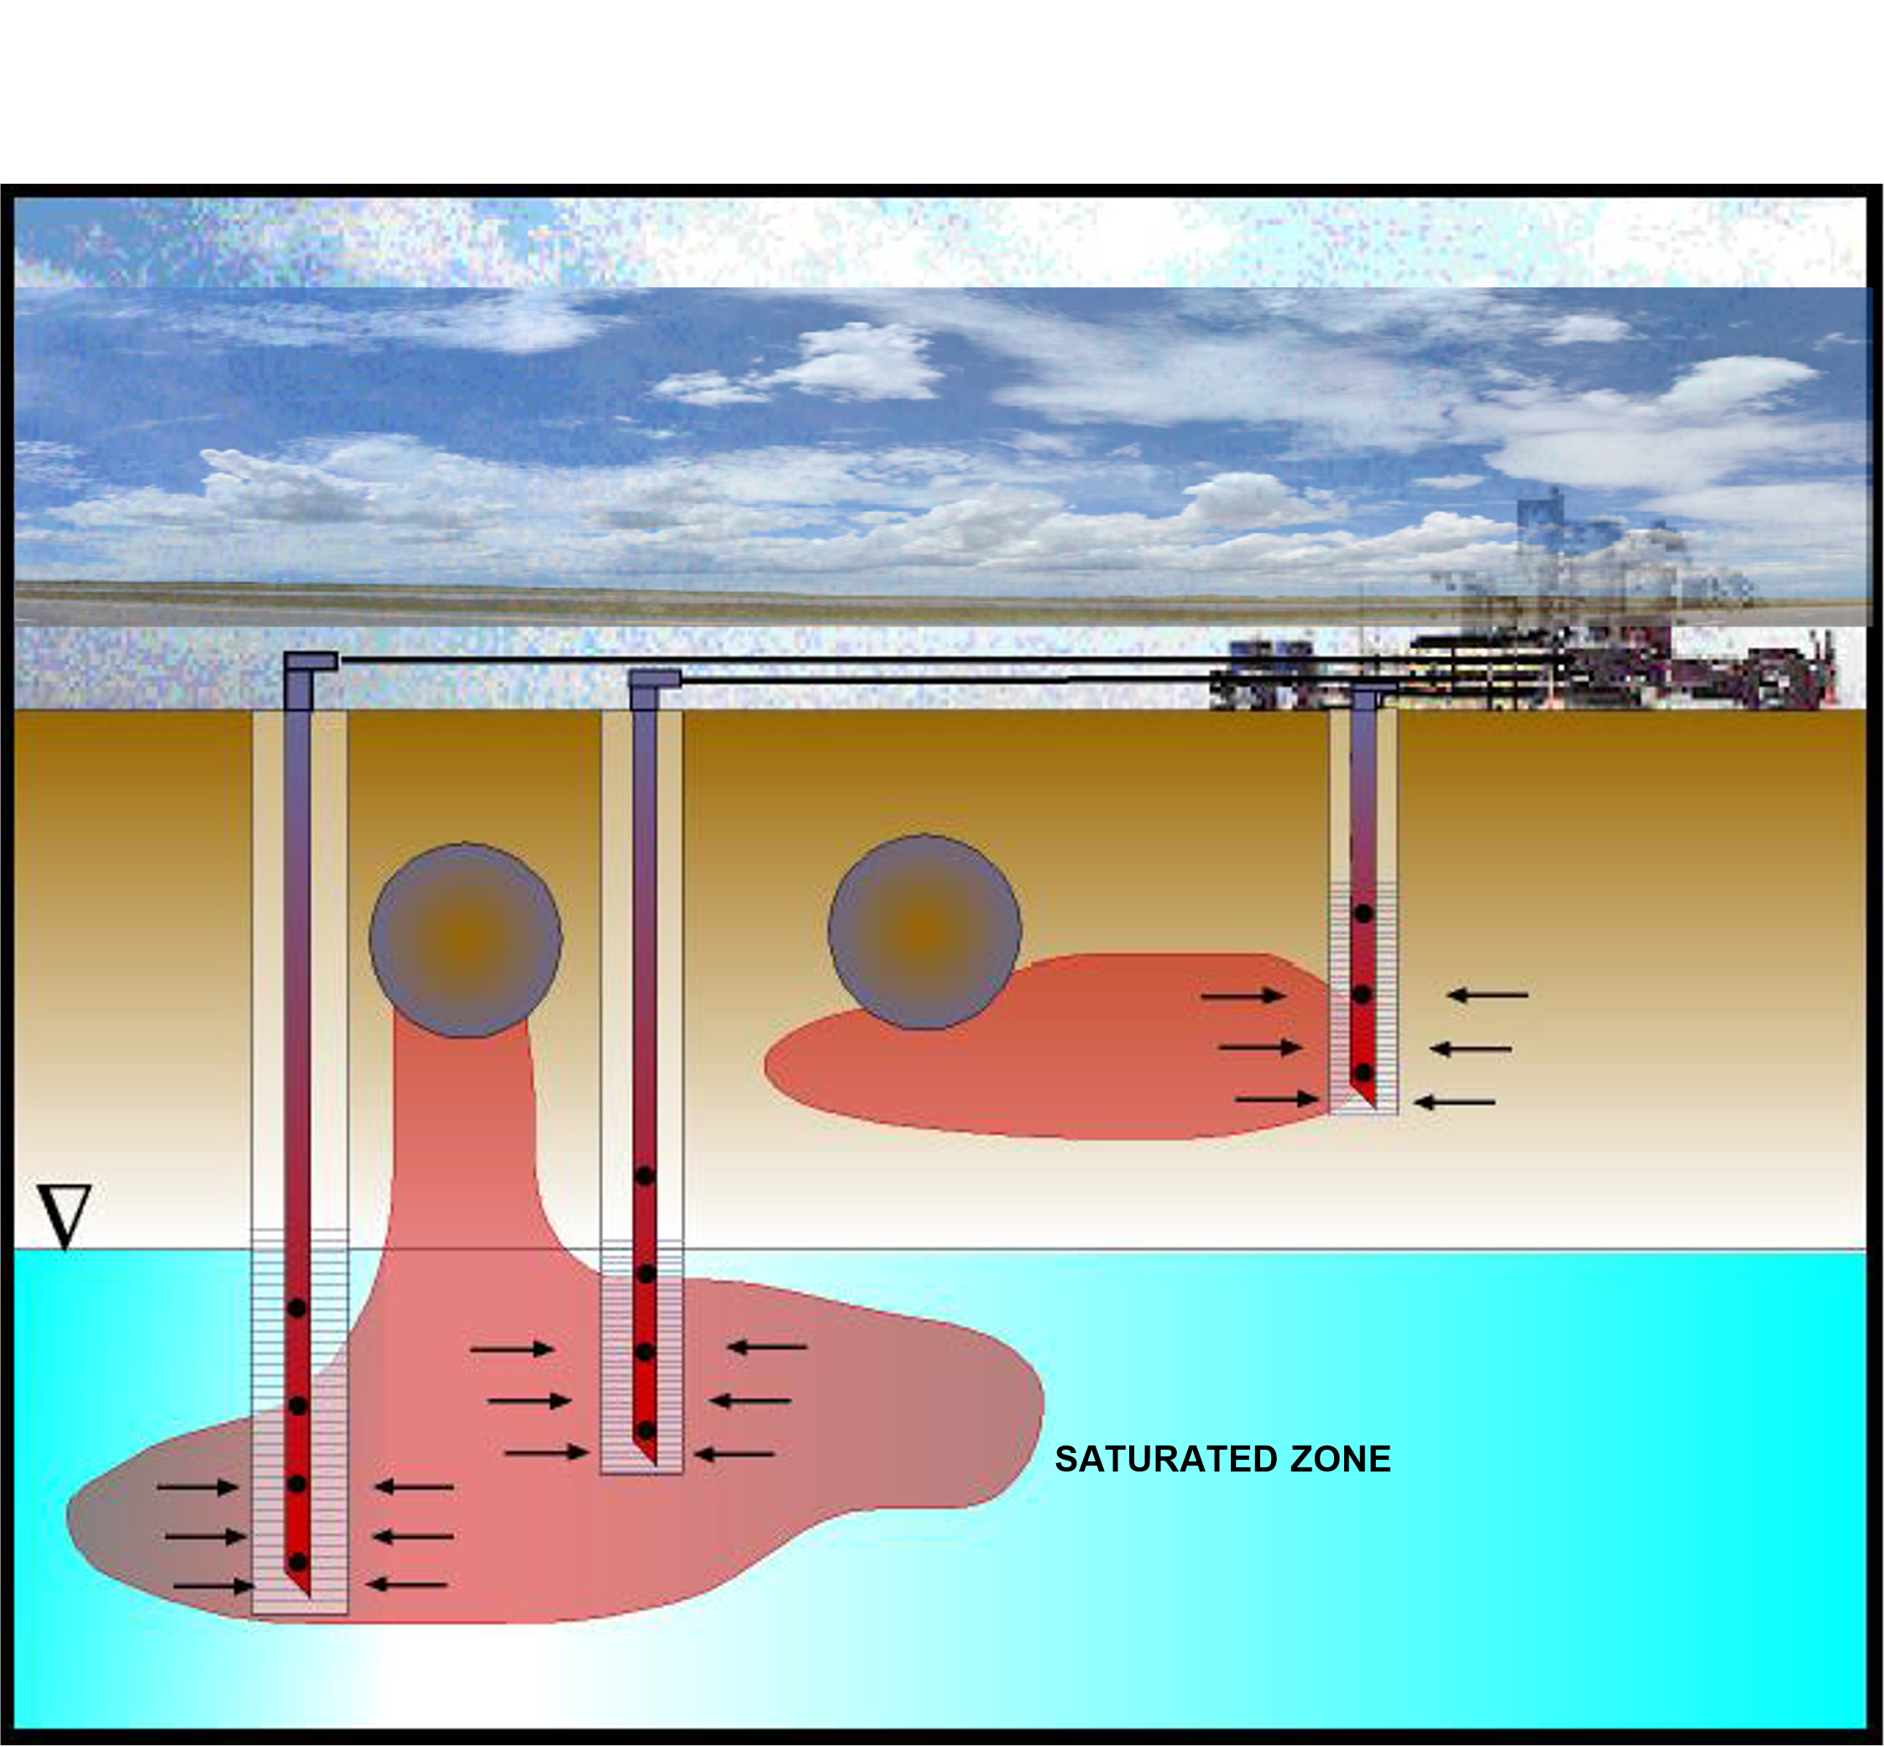

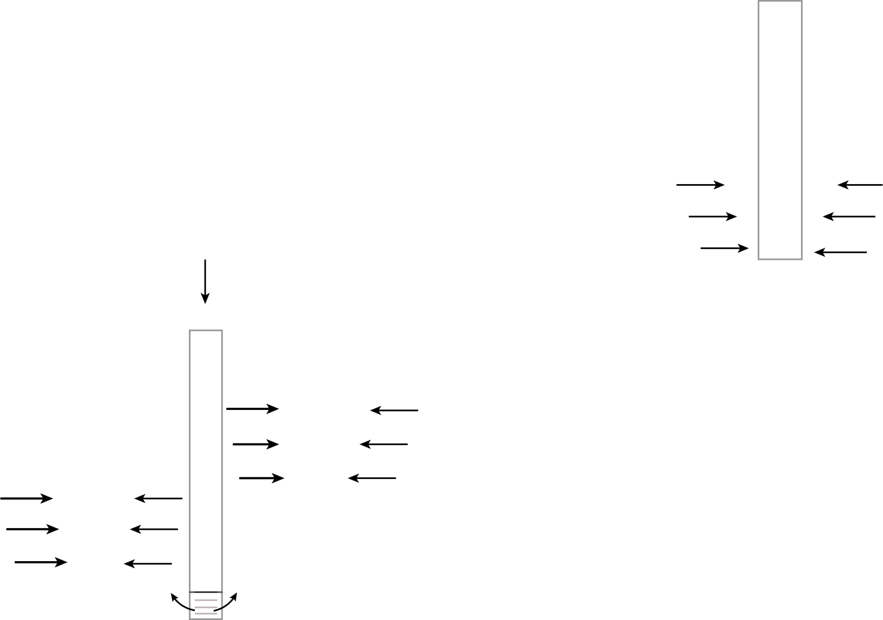



EXTRACTION PROCESS

Slide 6
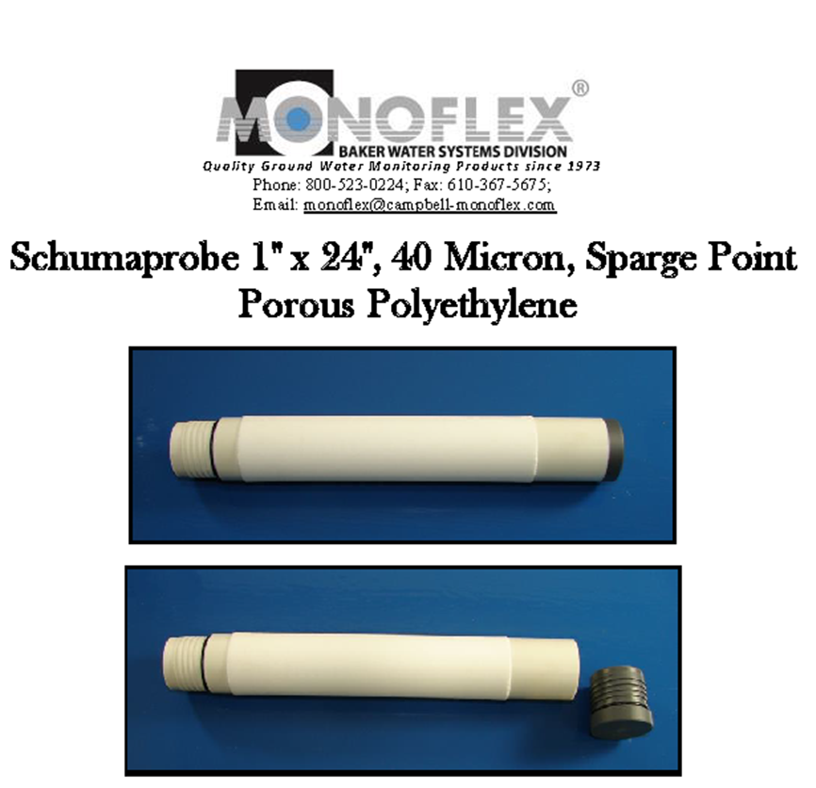
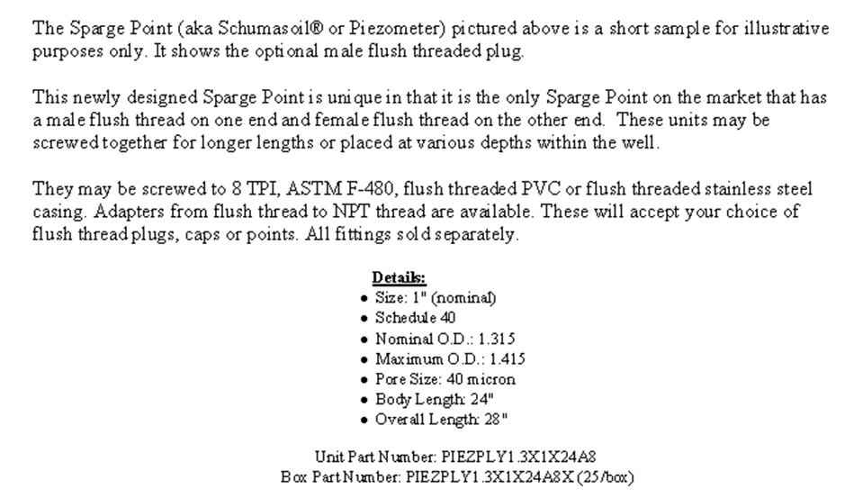

Slide 7
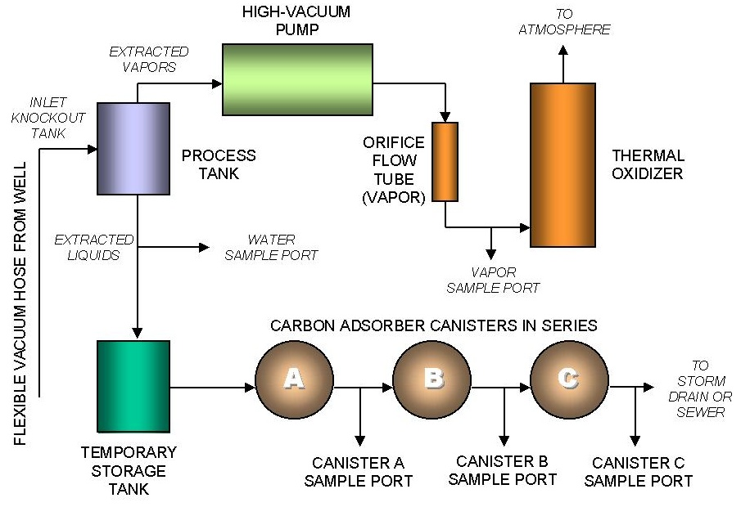
Flow Diagram For HVDPE
of Petroleum Hydrocarbons

Slide 8
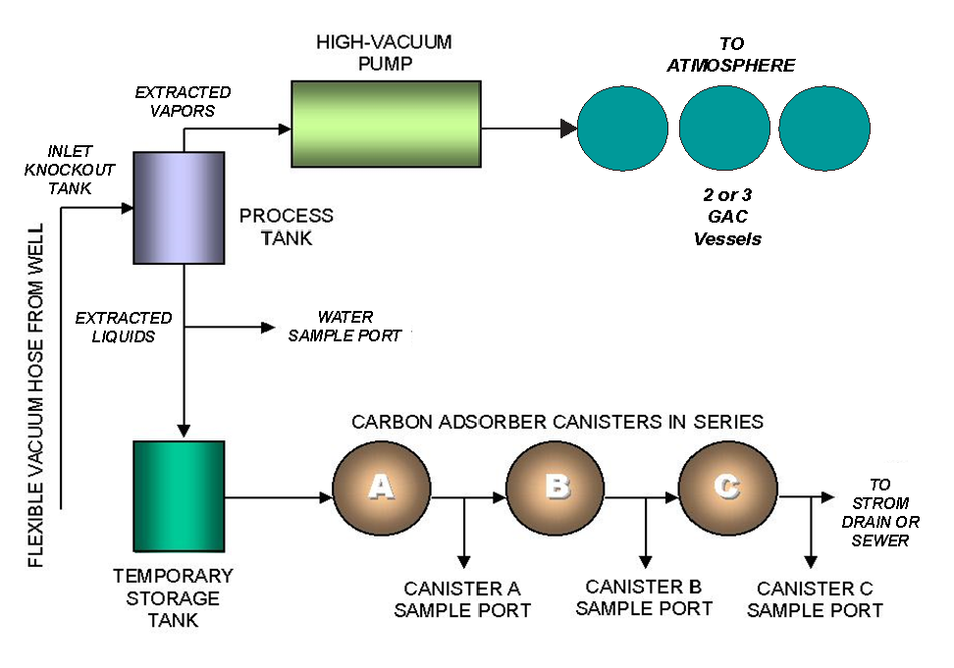
Flow Diagram For HVDPE
of Chlorinated Solvents

Slide 9
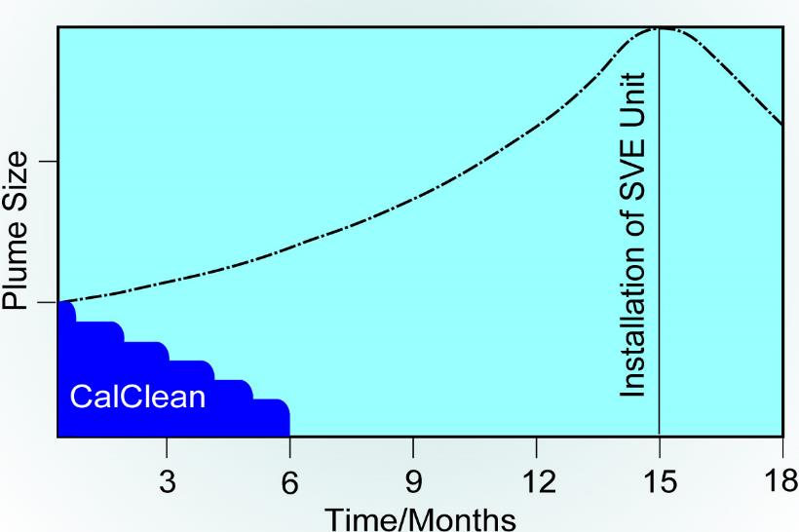
Plume Size: CalClean DPE
vs
Months of Installing a Fixed Based Unit
Installation of a Fixed Based Unit
Cone of Depression
DPE
Months

Slide 10
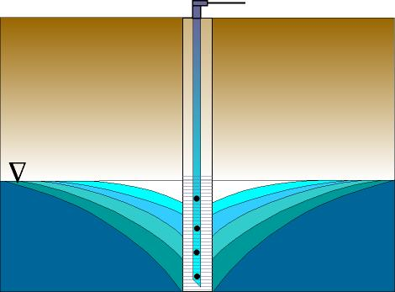
Vapor and Groundwater Extraction
8hr.*
24hr.*
5 days*
Cone of Depression
20 days*
1 month*
* TIMING FOR ILLUSTRATIVE PURPOSES ONLY
( Longer Events usually increase Cone of Depression and expose more saturated zone for vapor extraction)

Slide 11
Case Study #1
Chevron Station, Inglewood
1. 60-Day HVDPE Conducted (2013)
• Targeted free product removal
2. >10,000 Pounds of Hydrocarbons Extracted
• Significant source mass reduction
3. Case Closure Achieved (2016)
• Regulatory approval received

Slide 12
Case Study #2
Dodger Stadium (Former Unocal Gas Station), Los Angeles
1. Site History (2000–2020)
• Several million $ spent over two decades
• Persistent free product despite extensive remediation
  Targeted 90-Day HVDPE Event (2020)
• Conducted by CalClean
• Focused removal achieved with critical mass reduction
3. Post-Remediation Results
• Reached LTCP low-risk levels
• Case Closure granted in October 2021

Slide 13
Case Study #3
US Navy, Bangor, WA
  1. 30-Day HVDPE Event Conducted
• Targeted dual contamination: gasoline and PFAS
• Impact area spanned over 6 football fields
2. Treatment Approach
• Extracted vapors thermally abated at ~1,900°F
• Extracted groundwater treated:
– Initial carbon filtration for hydrocarbons
– Secondary treatment with specialized carbon for PFAS
3. Final Steps
• CalClean under consideration for full-scale remediation
• Proposed use of multiple mobile extraction systems

Slide 14
Case Study #4
US Navy, Keyport, WA
1. 90-Day Pilot Test Conducted
• Site history: Torpedo cleaning fluids at former landfill
• CVOC contamination from 5’ to 25’ bgs, with levels >500,000 ppb
• Depth to water (DTW): 3’–4’
Extraction Approach
• 3 extraction wells used
• DTW successfully lowered to 16’–17’
• Final 30 days included air sparging to enhance mass removal
Performance & Results
• Goal: 10 pounds of CVOCs over 90 days
• Actual: 10 pounds per day (900 pounds total)
Final Step
• Navy considering CalClean for full-scale site remediation

Slide 15
Case Study #5
Kennett Conoco, MO
Site Background (June 2015)
• LNAPL >3 ft. present in 18 wells across 4 properties (onsite and offsite)
• MTBE impacted city drinking water wells ½ mile downgradient (now shut down)
• Heterogeneous lithology: sand, clay, and some silt
Remedial Strategy
• Deployed 4 high-powered Mobile HVDPE units for simultaneous multi-well extraction
• LNAPL removed in ~4 months
• Post-LNAPL, 5 air sparge wells added to further increase mass removal
Results & Impact
• ~7 million gallons of groundwater removed in ~21 months
• Dissolved groundwater concentrations reduced below DTLs/RBTLs in all onsite wells
• ~404,000 lbs. (~65,000 gallons) of vapor-phase gasoline removed in ~12 months
(as of 03/31/2017)
• As of now, only 1 well remains slightly above closure level

Slide 16

Standard Rate Sheet (Revised June 1, 2025)
1-5 days of continuous usage | Net 30 Price $14,690 | PWP* Price $16,315
6 days of continuous usage | $18,170 | $20,125
7 days of continuous usage | $21,640 | $23,930
8 days of continuous usage | $25,120 | $27,740
9 days of continuous usage | $28,590 | $31,550
10 days of continuous usage | $32,070 | $35,350
11 days of continuous usage | $35,540 | $39,160
12 days of continuous usage | $39,020 | $42,970
13 days of continuous usage | $42,490 | $46,780
14 days of continuous usage | $45,970 | $50,590
15 days of continuous usage | $49,440 | $54,400
16 days of continuous usage | $49,440 | $54,400
17 days of continuous usage | $49,440 | $54,400
18 days of continuous usage | $49,440 | $54,400
19 days of continuous usage | $49,440 | $54,400
20 days of continuous usage | $49,440 | $54,400
21 days of continuous usage | $49,440 | $54,400
22 days of continuous usage | $49,440 | $54,400
23 days of continuous usage | $49,440 | $54,400
24 days of continuous usage | $49,440 | $54,400
25 days of continuous usage | $49,440 | $54,400
26 days of continuous usage | $49,440 | $54,400
27 days of continuous usage | $49,440 | $54,400
28 days of continuous usage | $49,440 | $54,400
29 days of continuous usage | $49,440 | $54,400
30 days of continuous usage | $49,440 | $54,400
31+ days | $1,648 /day | $1,813/day
* PWP = Pay When Paid within 15 days
COMPENSATION
Client shall pay CalClean the following lump sum and unit price bill rates for work performed. Such payments shall be deemed to include all of CalClean’s costs, overhead, and profit for accomplishing such work.
ALL INCLUSIVE BILL RATES FOR HIGH VACUUM DUAL PHASE EXTRACTION SERVICE
Equipment downtime of up to two hours per day average for maintenance/repairs of equipment is included in the rates. Additional downtime may be made up at end of event. Rates are portal to portal from job site to job site. Usage of additional trucks will follow above listed pricing.

Slide 17
* The All-Inclusive Bill Rates include the following:
Free technical input from company engineer for site cleanup optimization
Low noise truck or trailer-mounted 25-hp, 450-CFM high-vacuum Liquid Ring Pump for high-vacuum dual phase extraction (HVDPE) or high-vacuum soil vapor extraction (HVSVE)
Inlet knockout tank for entrained liquids and solids
Transfer pump capable of transferring liquids when unit is under high vacuum (>21”Hg)
Required hoses (up to 1-1/4” diameter; larger diameter hoses will be billed at cost)
Well seals for up to 5 extraction wells (2”, 3”, or 4”)
Onsite traffic control cones, delineators and flags (Street Traffic Control not included)
Rubberized traffic-rated ramps to protect vacuum up to 1” diameter extraction hoses
Generator for electric power and diesel for the generator (See 1.2 below)
Propane as supplemental fuel for thermal/catalytic oxidizer system (See 1.2 below)
One equipment operator during the project (8 hours per day) to take readings (maximum 4 observation wells at a time and no more often than once every four hours), including vacuum and groundwater depth measurements. Additional hours and/or a second operator at $65/hour.
Horiba MEXA-324 analyzer for field measurements of gasoline range hydrocarbons (up to 10,000 ppmv measured as Hexane)
Depth sounder or interface probe for groundwater depth measurements
Manometers or magnehelics for vacuum measurements in observation wells
1.2
VARIABLE COSTS
Mob/Demob of Groundwater Treatment Trailer $1,000 per event per job site
Groundwater Treatment System (Includes carbon disposal as non-haz)
- $0.40/gallon, Maximum Charge for water treatment is $28,000 for a 30-day event
Electrical Down Hole Pump $110 per day per pump (Pneumatic down hole pump cost quoted per project)
Tedlar Bags for Vapor Samples $16.00 each
Per Diem
For events greater than 30 consecutive days For events less than 30 consecutive days
Included in rates
$170/day/person
Mob/Demob of Truck-Mounted System
For locations within 50 miles of CalClean Storage Facility
Included in rates
For locations more than 50 miles of CalClean Storage Facility
$10.00/mile
Permits for Air Districts or Water Discharge
Various Locations Permits Included in all-inclusive rates.
specific permits are billed at
Modification of air permit costs (such as K-12 school notification in CA) for specific site are billed at cost.

Slide 18
Diesel Fuel for System
Actual costs to CalClean between $0.90 and $1.70 per gallon are included in the all-inclusive rates. A fuel price adjustment will be made for actual costs below or above these amounts.
Propane for System
Actual costs to CalClean between $0.70 and $1.50 per gallon are included in the all-inclusive rates. A fuel price adjustment will be made for actual costs below or above these amounts.
Mark-Up on Other Costs
CalClean may mark up 10% other costs incurred that are not part of CalClean’s normal operations (e.g. lab costs, storage tanks, etc.).
INVOICING
At the end of each job or every 30 days (in case a project is longer than 30 days), CalClean will submit an original, faxed or emailed invoice for Work performed at the specific site. Invoice terms are Net 30 days.
ADDITIONAL PAYMENT PROCEDURE
If Client pays an invoice immediately upon receipt, CalClean shall grant and Client shall take a 2% discount against the invoice total. If Client pays an invoice within 10 days of invoice receipt, CalClean shall grant and Client shall take a 1% discount against the invoice total. Other discounts may be provided from time to time for early payment. Standard terms for payment are net 30 days.
CANCELLATION FEE
Client understands that CalClean is making best efforts to schedule an event for Client. If Client schedules an extraction event and then cancels or postpones the event within seven calendar days of the start of the event, a cancellation fee of $1,000 per extraction day may be billed.
SPECIAL PROVISIONS
Client understands that costs and terms provided in a site-specific proposal would govern the work. Rates in this Schedule may change based on specific job site conditions that might warrant higher or lower system costs, or other costs. To avoid misunderstandings, Clients are encouraged to request site-specific written quotes. We can be reached at (714) 936-2706 or via email at noelshenoi@calclean.com

Slide 19
Recommendations
Plan 60-90+ day HVDPE Events
Get sewer or NPDES or reinjection permits to reduce disposal costs
Set up grid power to reduce high diesel costs (208-240v, 1Ø or 3Ø, 125 amps min)
Conduct Air Sparge to assist HVDPE
Install Air Sparge wells using micro bubblers 5’ below source area
Strategic site grouping for cost efficiency, identify 2 or more sites close by (within ≈ 50 miles) to reduce labor costs
Low Noise For 24-Hour Operations In Neighborhoods
Occupies Less Space at Station
Can extract from depths >270 feet
100% Guaranteed Up Time
Qualified Technical Expertise And Supervision

Slide 20
Summary
Revise work plans to conduct 60-90+ Day events
Use of Air Sparging to assist HVDPE
Big savings using Grid Power
CalClean can dedicate one or more remediation systems for your project(s)

